Slide 1
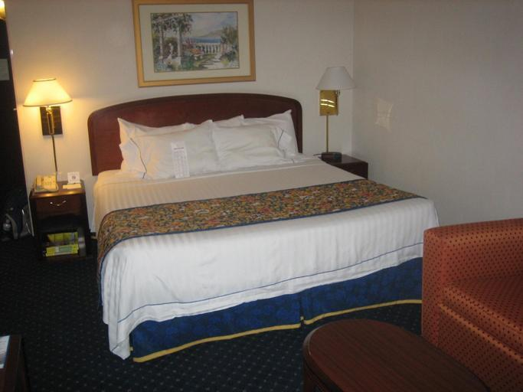
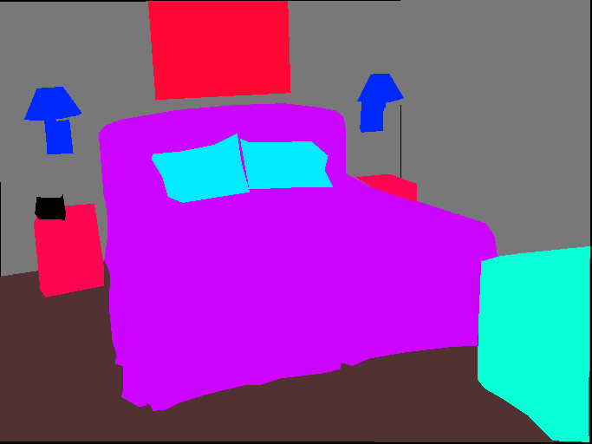
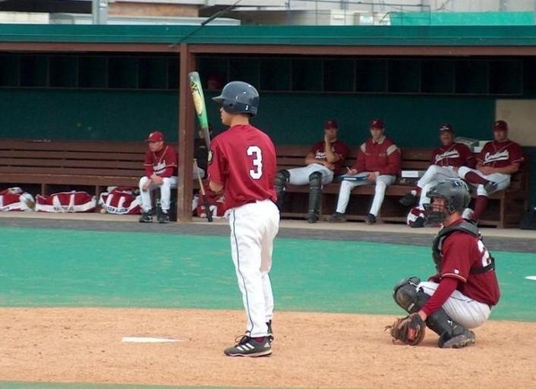
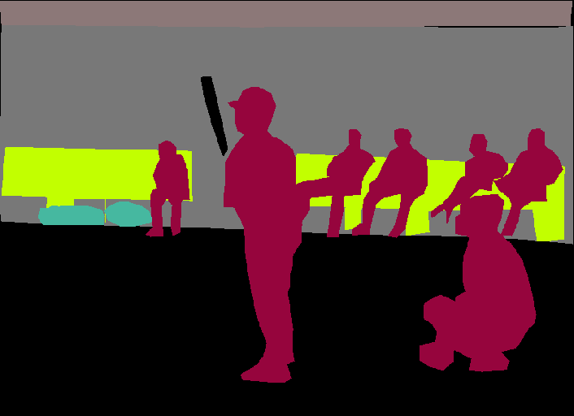
Baseline method
Dataset | Model architecture
ADE-20K | Encoder | Decoder
 | ResNet50 | UperNet
20K images for training, 20K images for validation
150 semantic categories
Stuffs: sky, road, grass …
Discrete objects: person, car, bed …

Slide 2
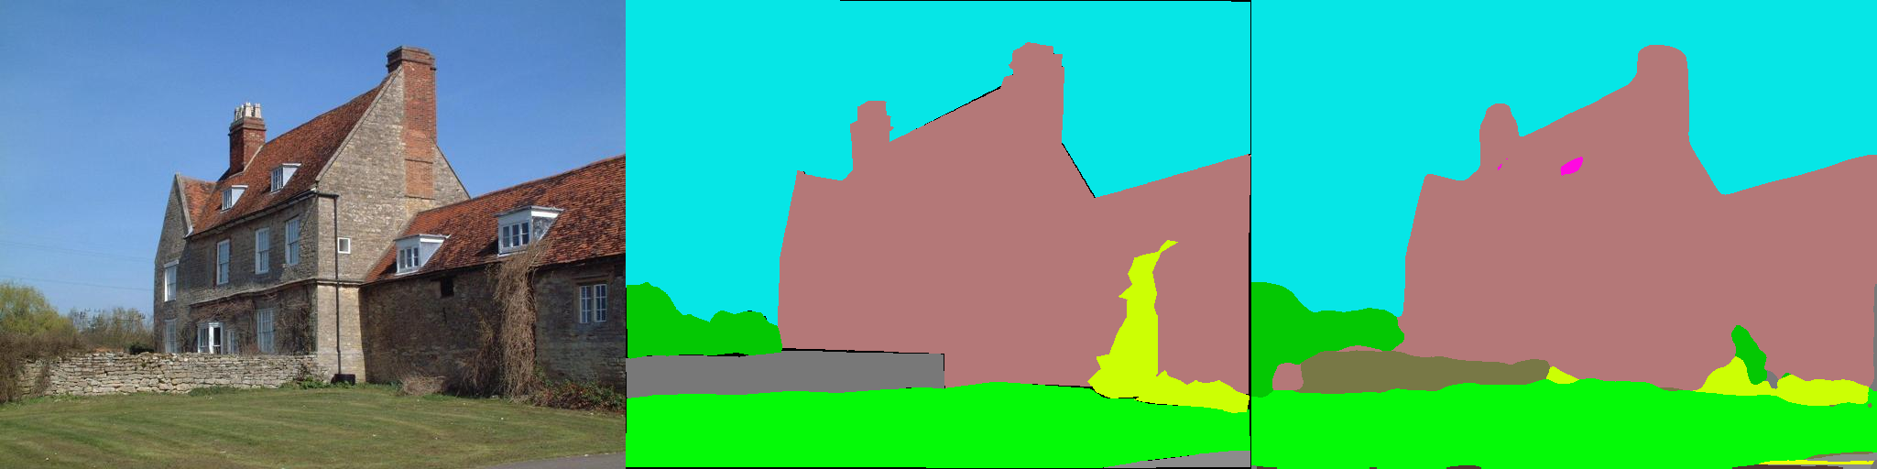
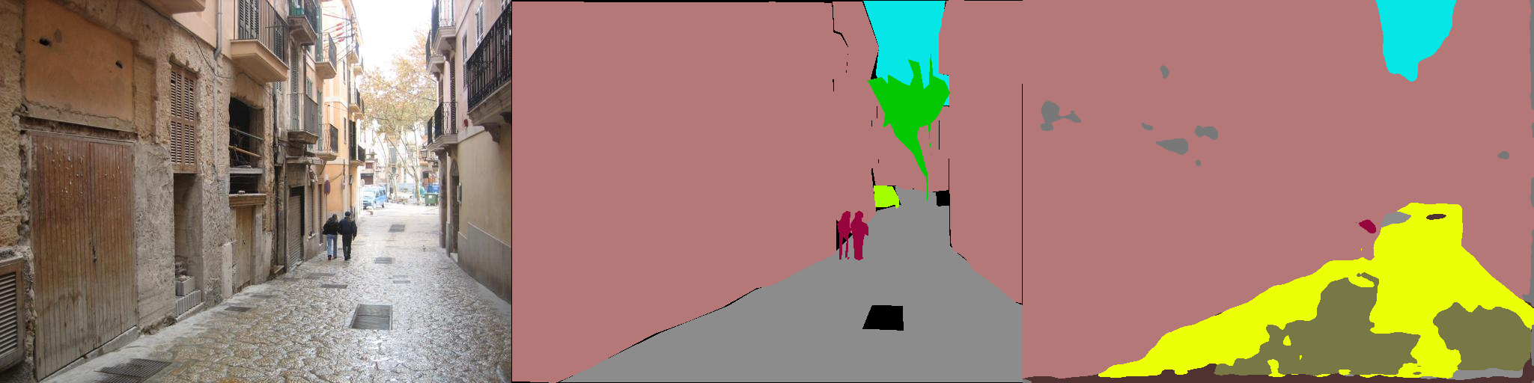
Baseline performance
Dataset | Model | Start Lr | vGPUs | Epoch | Training accuracy | Validation accuracy
ADE-20K | ResNet50-UperNet | 0.02 | 1 | 10 | 61.6 | 53.8
Original image
Annotation
Prediction

Slide 3
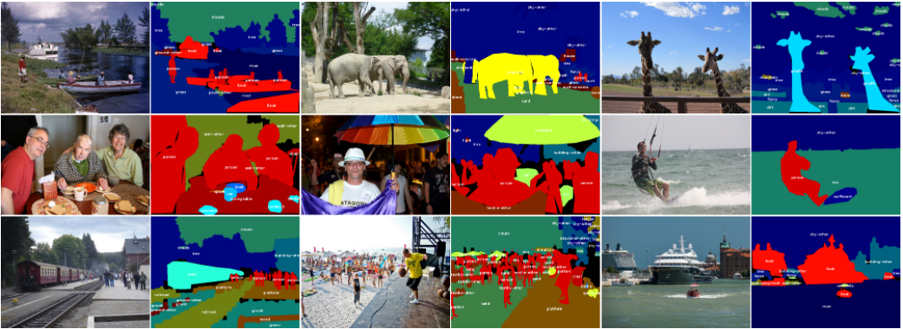
New dataset – Coco Stuff (Coco10K)
10K images for training, 1K images for validation.
91 thing classes and 91 stuff classes.
The smallest subset of the entire Coco-Stuff dataset

Slide 4
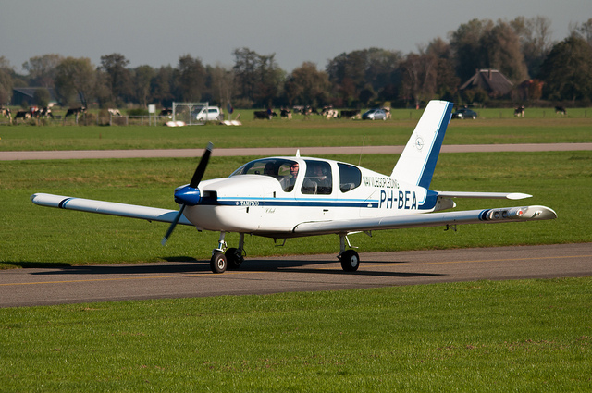
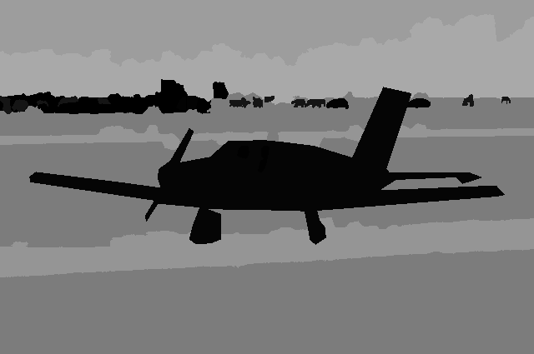
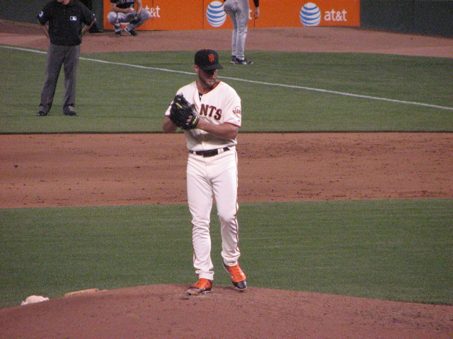
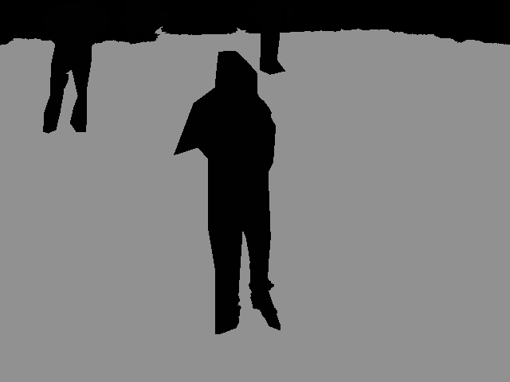
Apply the original model to the new dataset
Original image
Annotation

Slide 5
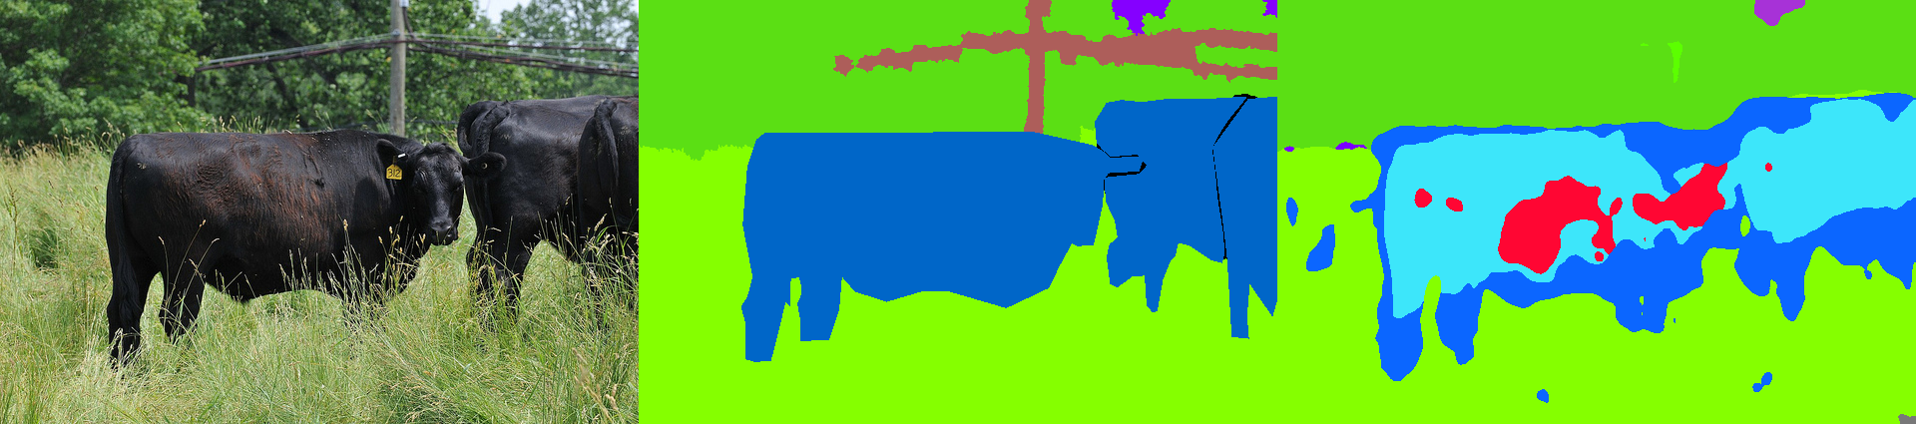
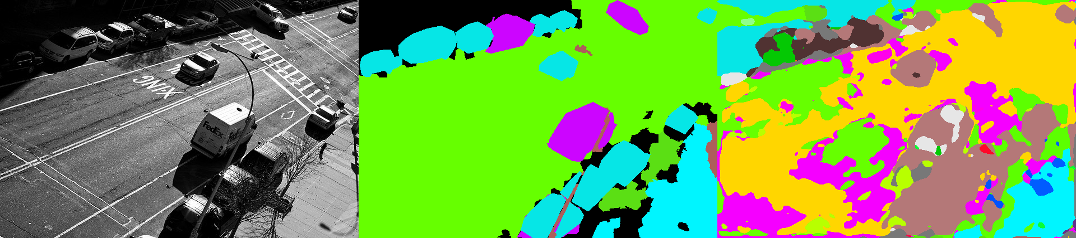
Performance of the new Dataset
Dataset | Model | Lr | Epoch | Training accuracy | Validation accuracy
Coco10K | ResNet101-Upernet | 0.02 | 10 | 57.1 | 49.4
Original image
Annotation
Prediction

Slide 6
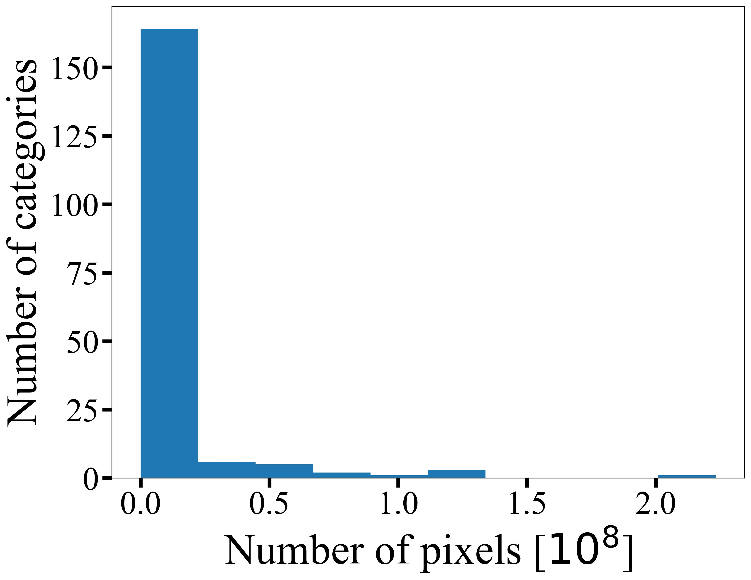
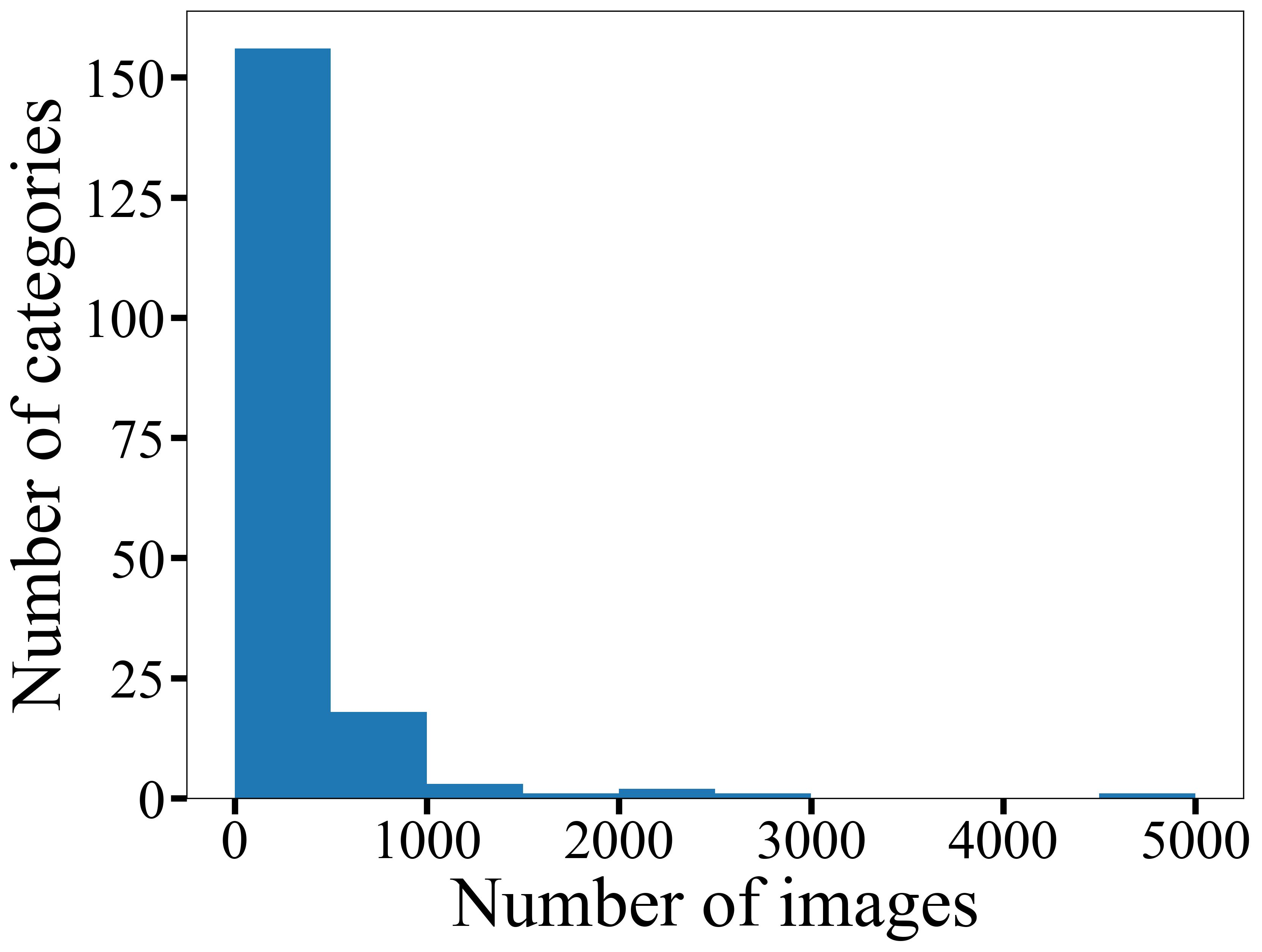
Why performance degrades with new dataset?

Slide 7
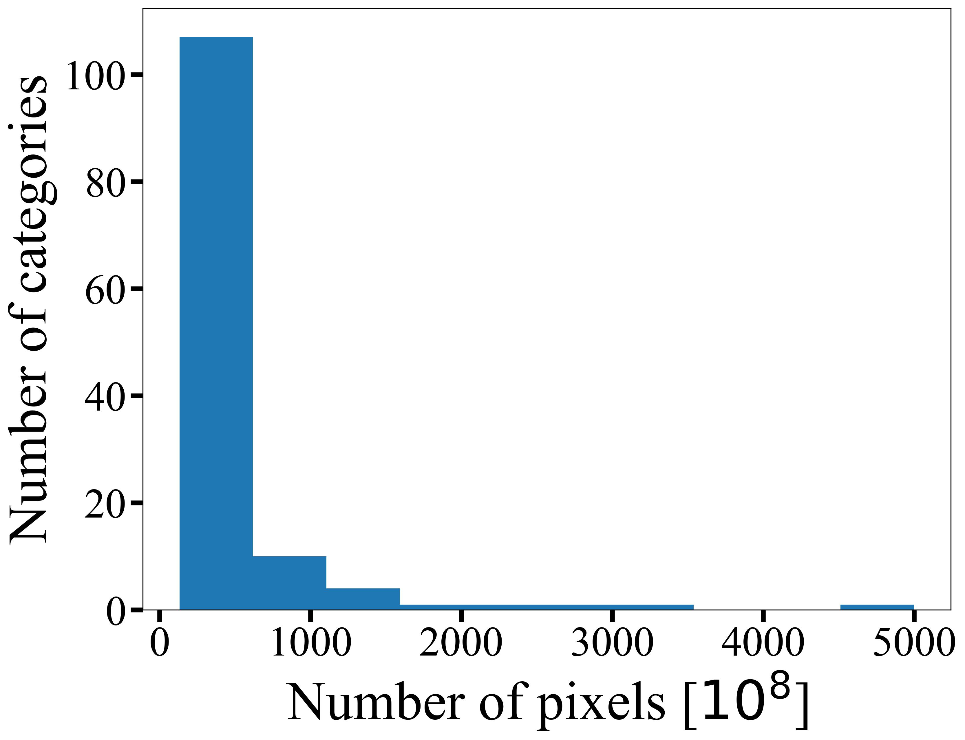
Improvement step 1 – combine categories

Slide 8
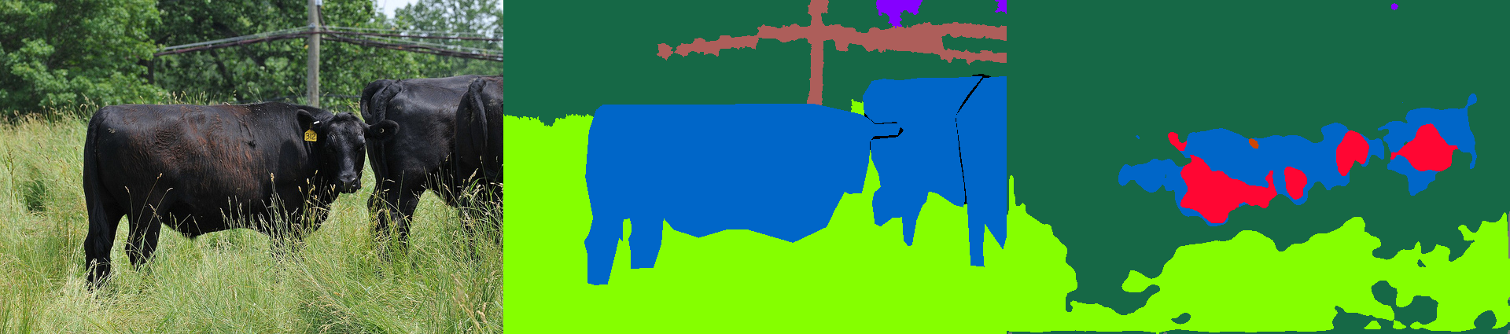
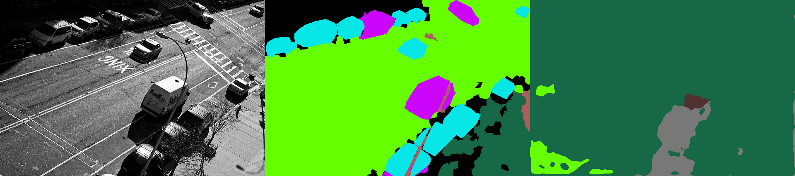
How much improvement do we get
Dataset | Model | Lr | Epoch | Training accuracy | Validation accuracy
Coco10K | ResNet101-Upernet | 0.02 | 10 | 57.1$→$59.7 | 49.4$→$52.4
Original image
Annotation
Prediction

Slide 9
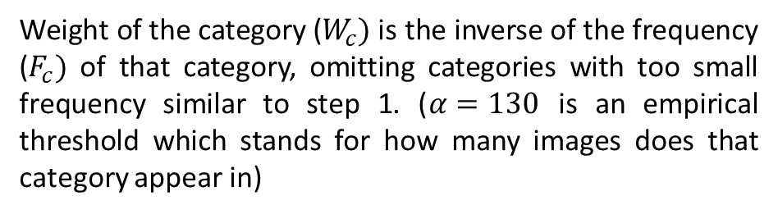
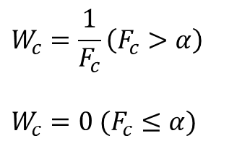
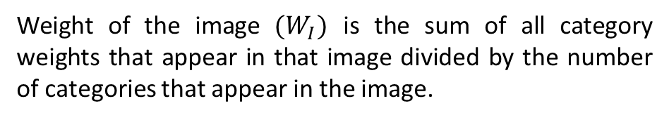
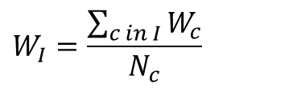
Improvement step 2 – applying different weights to images
$$W_{c}=\frac{1}{F_{c}}\left(F_{c}>α\right)$$
$$W_{c}=0 (F_{c}≤α)$$
Weight of the category ($W_{c})$ is the inverse of the frequency ($F_{c})$ of that category, omitting categories with too small frequency similar to step 1. ($α=130$ is an empirical threshold which stands for how many images does that category appear in)
$$W_{I}=\frac{\sum_{c in I}{W_{c}}}{N_{c}}$$
Weight of the image $(W_{I})$ is the sum of all category weights that appear in that image divided by the number of categories that appear in the image.

Slide 10
How much improvement do we get
Dataset | Model | Lr | Epoch | Training accuracy | Validation accuracy
Coco10K | ResNet101-Upernet | 0.02 | 10 | 59.7$→$xx.x | 52.4$→$xx.x
Original image
Annotation
Prediction

Slide 11
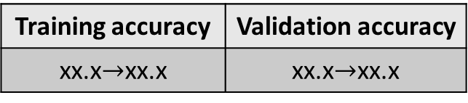
Conclusion
Applying original model to the new dataset, 3 steps to make improvement:
Combine very low frequency categories.
Assign different weights to images.
Use pretrained model from original dataset.
Final improvement
Training accuracy | Validation accuracy
xx.x$→$xx.x | xx.x$→$xx.x

Slide 12
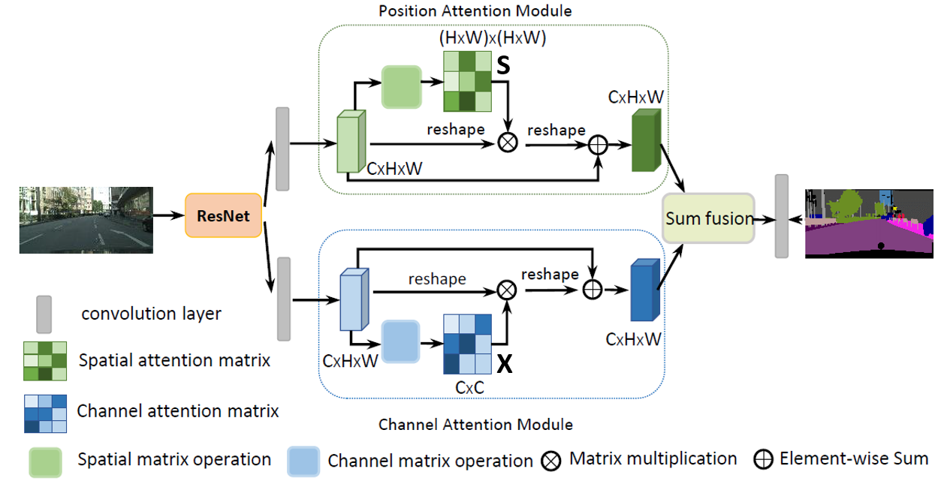
New decoder – Dual Attention Network (DANet)
Different from UPerNet that improves performance by fusing multi-scale features, DANet utilizes the inter-spatial relationship o features and applies attention modules before final prediction.
https://arxiv.org/abs/1809.02983

Slide 13
UPerNet vs DANet
Dataset | Model | Lr | Epoch | Training accuracy | Validation accuracy | Validation IOU
Ade20k | ResNet50dilated-DANet | 0.02 | 20 | 67.39 | 63.04 | 0.1191
Ade20k | ResNet50dilated-UperNet | 0.02 | 20 | ? | 63.52 | 0.1213
Before we go into the details, do we have to know that the models are poorly trained due to limited computational resource:
It is suggested by some similar studies that the training epoch should be 40 with at least 4 gpus.
The averaging IOU is low because some classes are poorly trained. IOU for those class is nearly 0, which makes the overall averaging IOU low.
One experiment with 4 gpus:
Dataset | Model | Lr | Epoch | Training accuracy | Validation accuracy | Validation averaging IOU
Ade20k | ResNet50dilated-DANet with 4-gpu | 0.02 | 10 | 82.32 | 72.44 | 0.2545

Slide 14
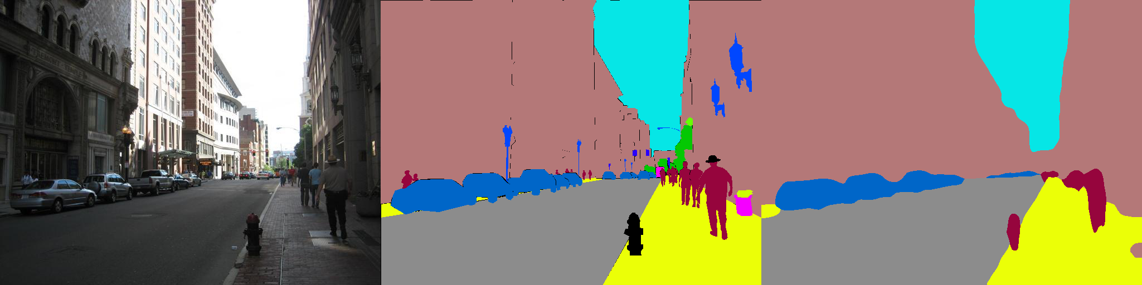
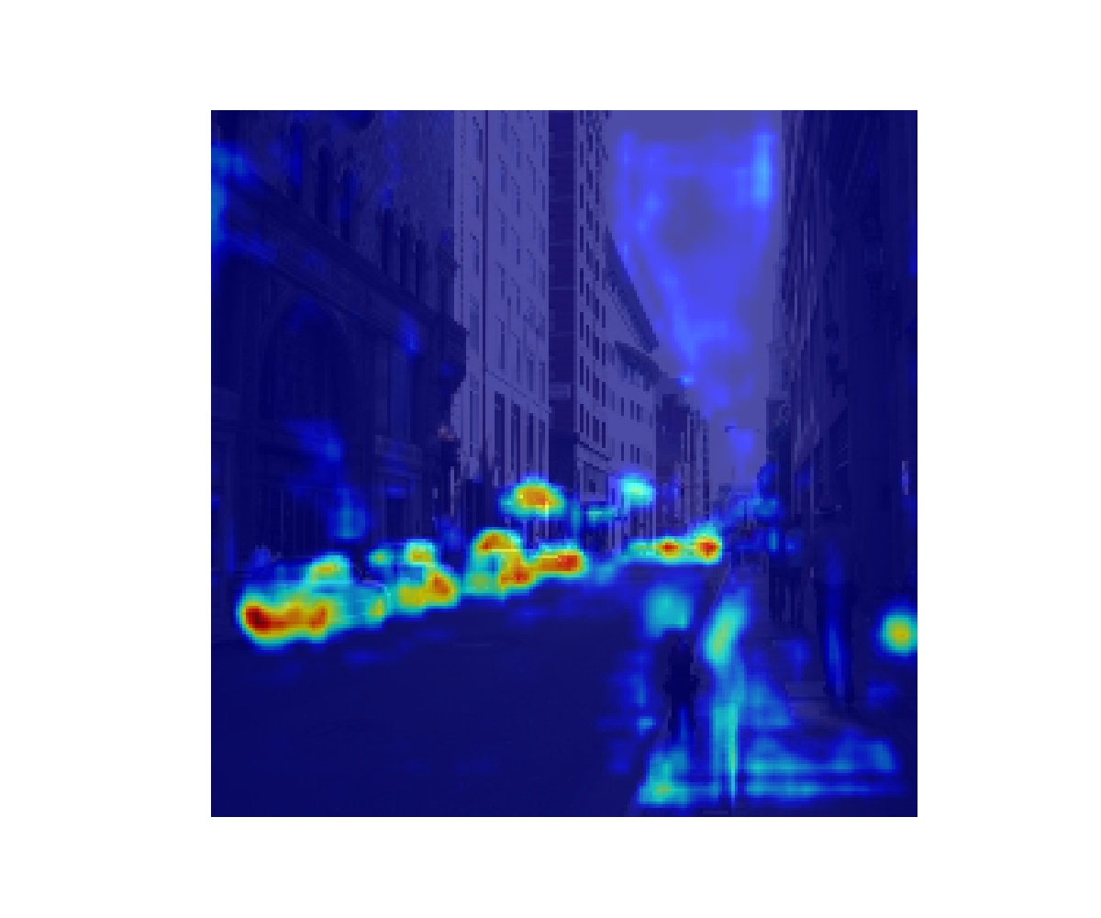
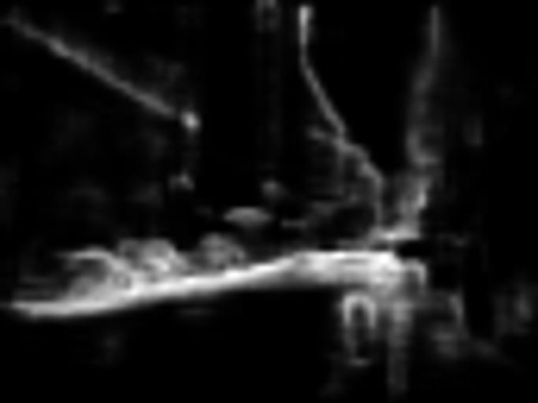
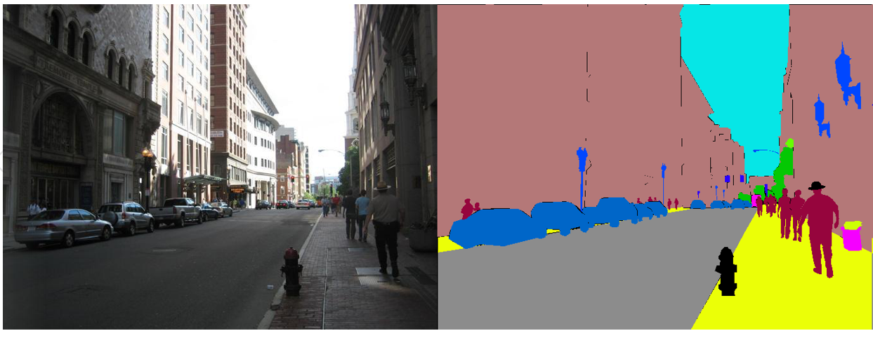

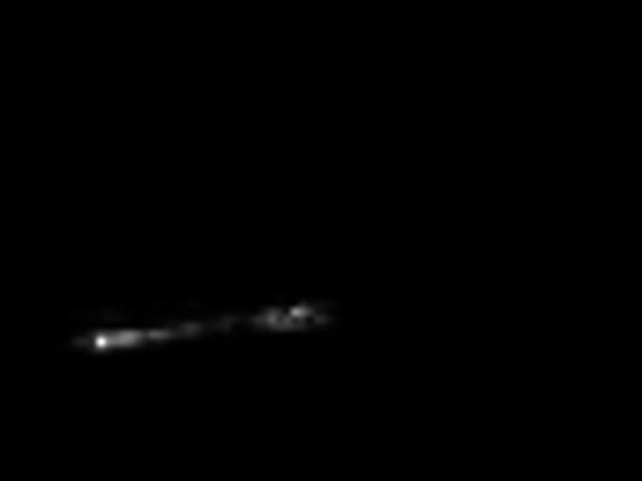
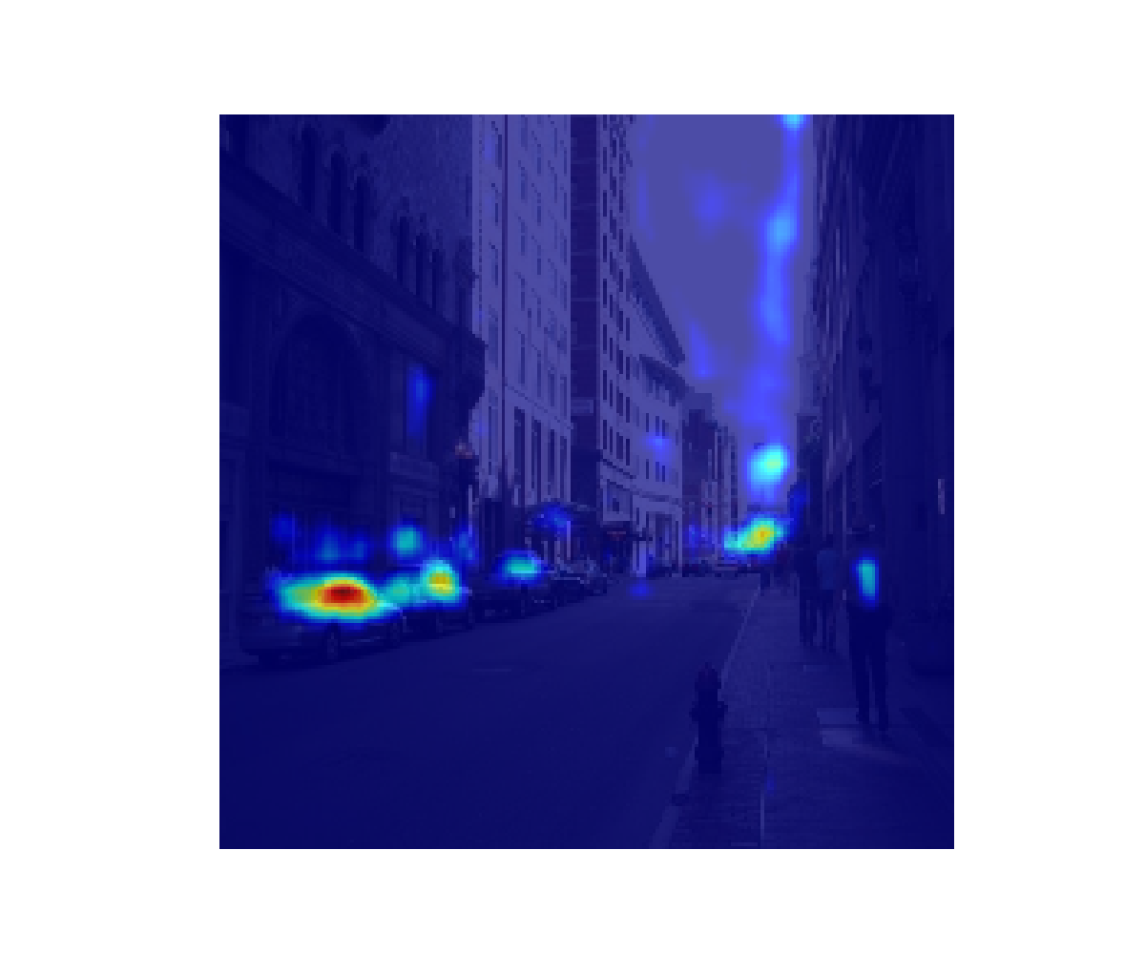
Ablation study for DANet: are attention modules effective with limited training epochs?
Dataset | Model | Lr | Epoch | Training accuracy | Validation accuracy | Validation IOU
Ade20k | ResNet50dilated-DANet | 0.02 | 20 | 67.39 | 63.04 | 0.1191
Ade20k | ResNet50dilated-DANet w/o attention modules | 0.02 | 20 | 68.68 | 58.30 | 0.1034
Attention map
Attention map

Slide 15

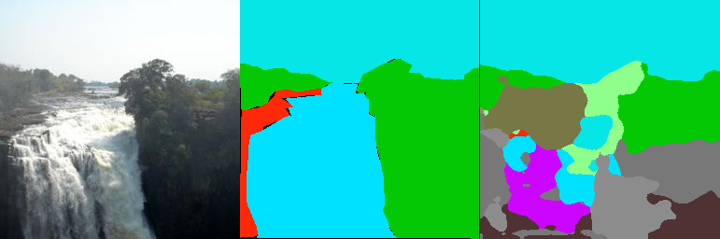
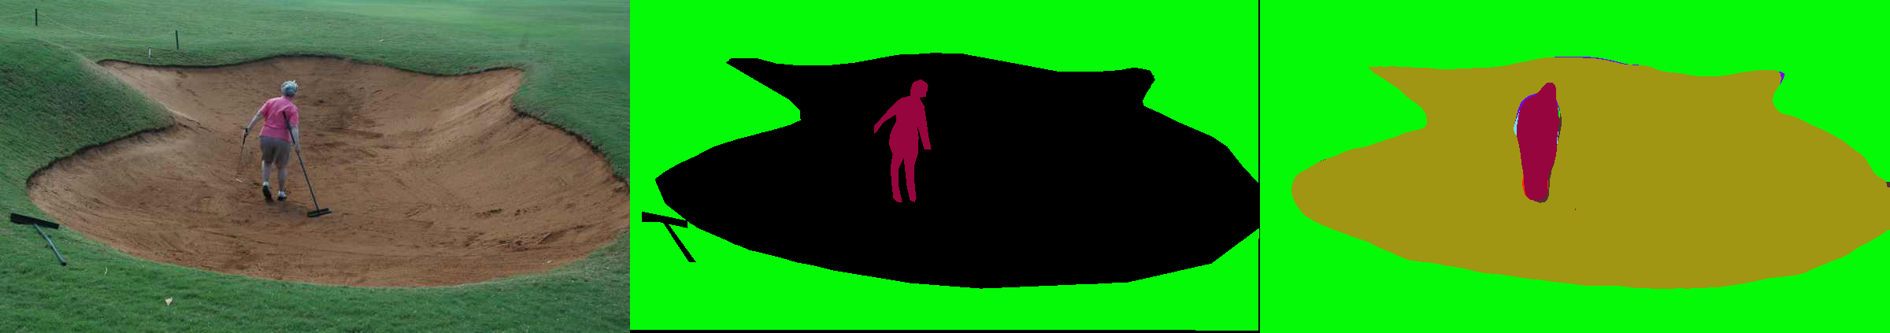
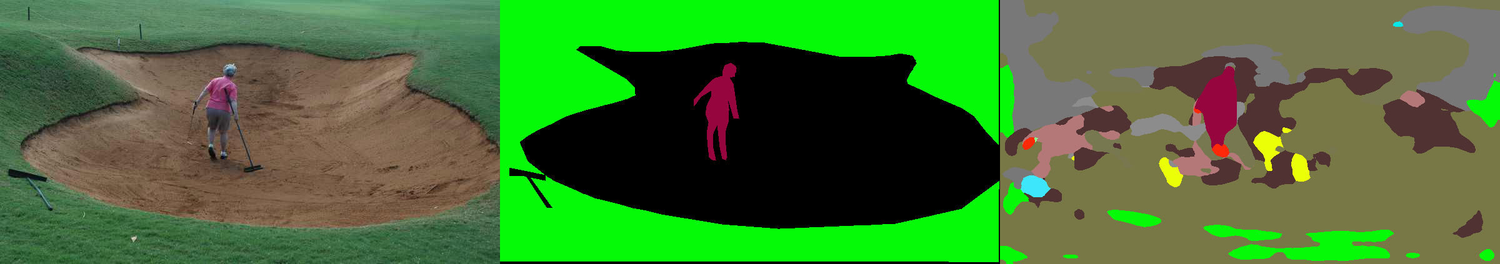

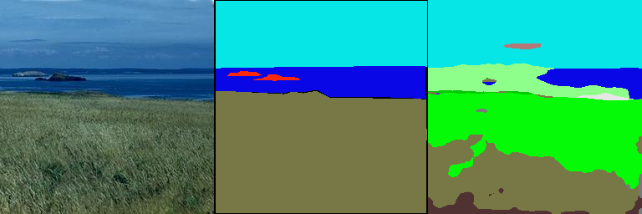
Ablation study for DANet: are attention modules effective with limited training epochs?
Image Ground Truth DANet DANet w/o attention
Even though DANet cannot segment the image with correct classification with limited training, it predict good segment boundaries.

Slide 16

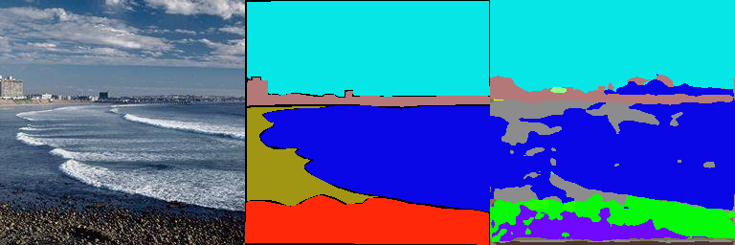
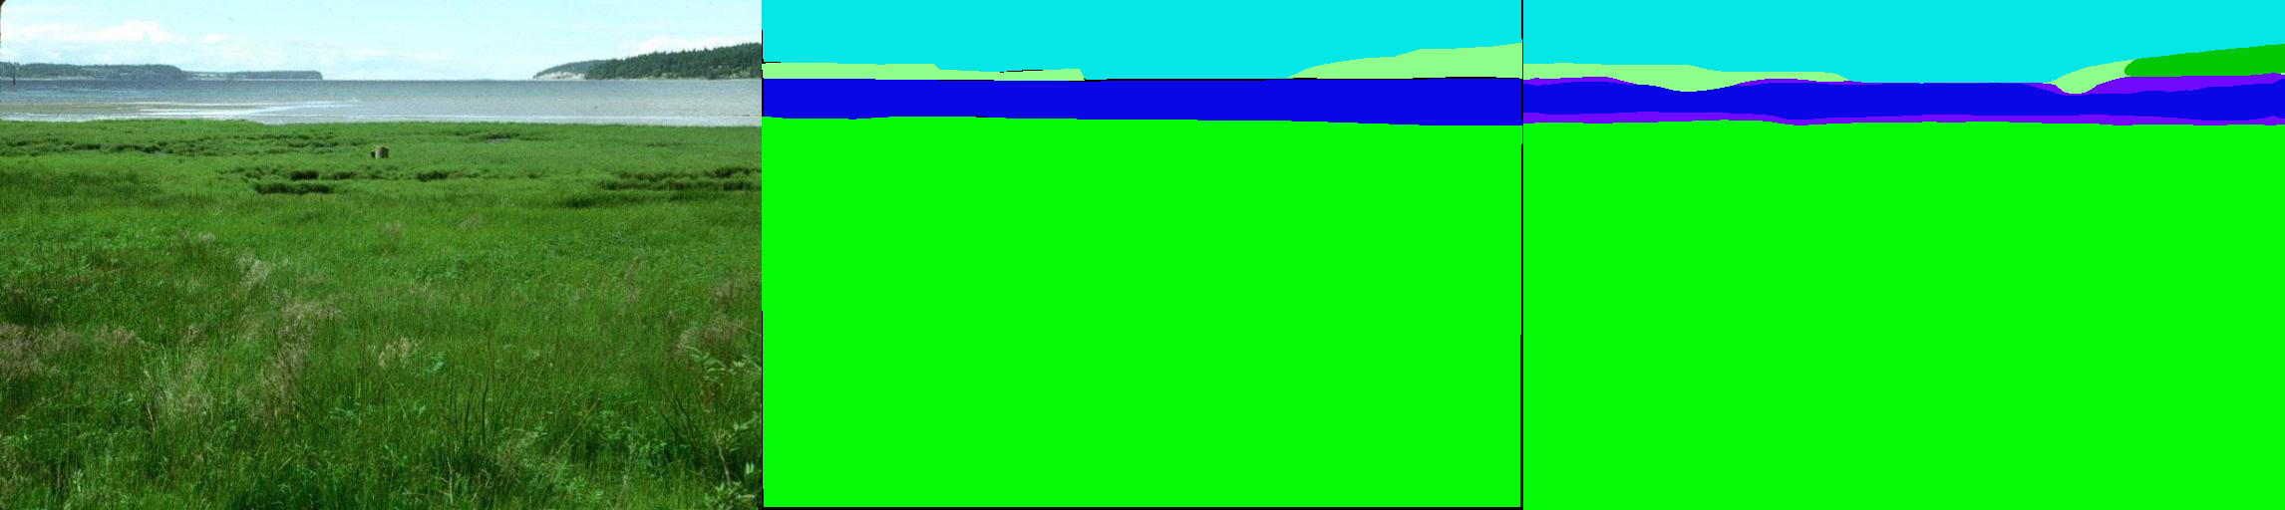
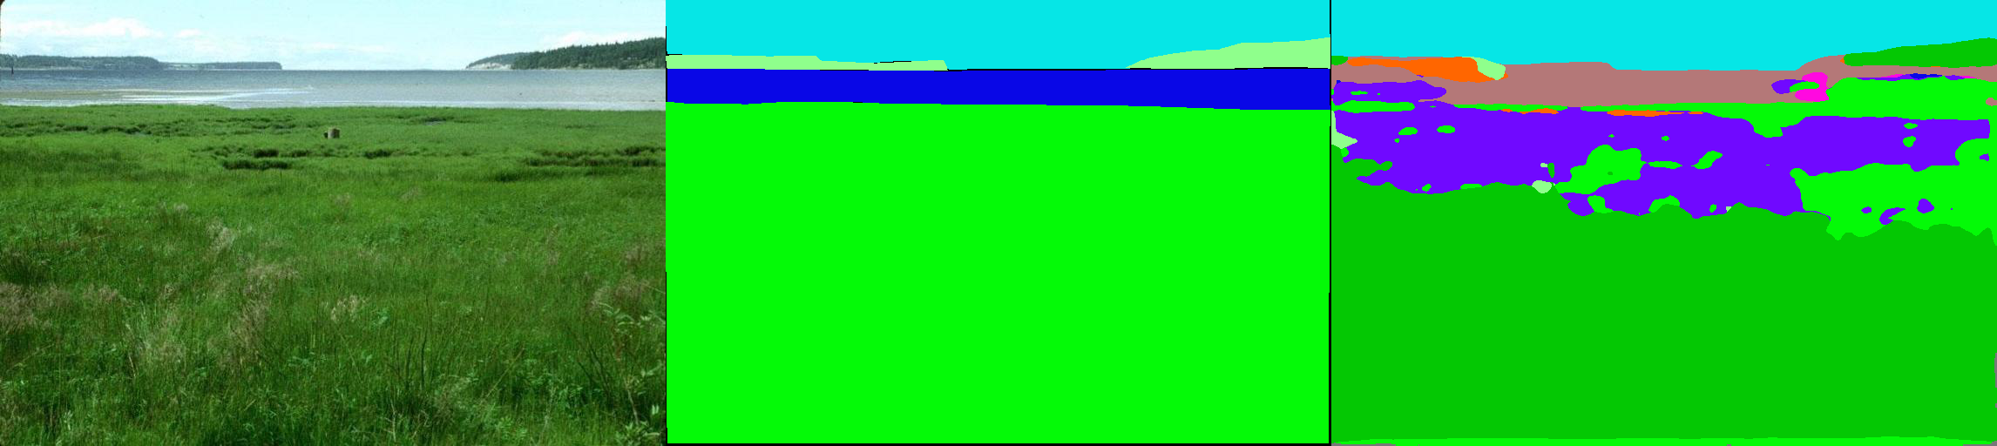
UPerNet vs DANet
Image Ground Truth DANet UPerNet
UPerNet is better
DANet is better
UPerNet can better capture detailed features compared to DANet
DANet is more likely to classify similar pixels into the same category and avoid deceived by details due to attention module.

Slide 17
Conclusions
For DANet:
Even though our model is poorly trained, the attention modules are proved to be effective
The reason why we achieve even higher pixel-wise accuracy when no attention modules are applies is because our models are still far away from the optimum with limited epochs, and the model is more difficult to train with attention modules.
Compared with UPerNet:
We are not able to compare which network can achieve better performance due to limited computing resource.
DANet is relatively good for big scenes where details are relatively not important.
UPerNet is relatively good for scenes where different features are at different scales.

Slide 18
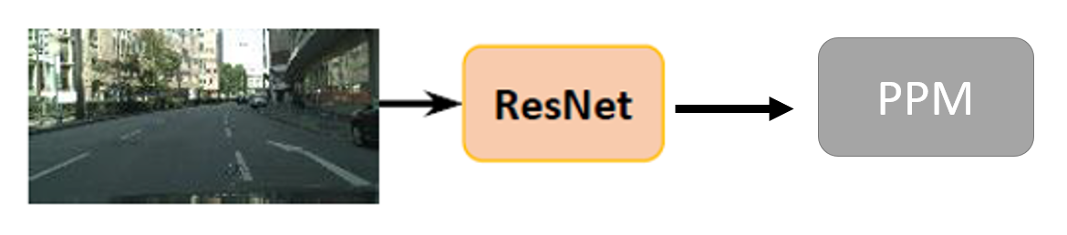
New decoder – PPM-DANet

Slide 19
New decoder – PPM-DANet
Dataset | Model | Lr | Epoch | Training accuracy | Validation accuracy | Validation averaging IOU
Ade20k | ResNet50dilated-DANet with 4-gpus | 0.02 | 10 | 82.32 | 72.44 | 0.2545
Ade20k | ResNet50dilated-PPM_DANet with 4-gpus | 0.02 | 10 | 83.63 | 68.82 | 0.2954
Both models are still not well trained even with 4 gpus (averaging IOU is still very low)
PPM-DANet has higher averaging IOU even though the pixel-wise accuracy is lower. This can be due to the fact that PPM-DANet has much parameters and is harder to train, but it can produce better predictions.
We cannot justify if PPM-DANet is a better model or not mainly for two reasons:
Limited computational power. We cannot train the model to optimum.
Limited time. We did not carefully tune the hyper-parameters when training.

Slide 20
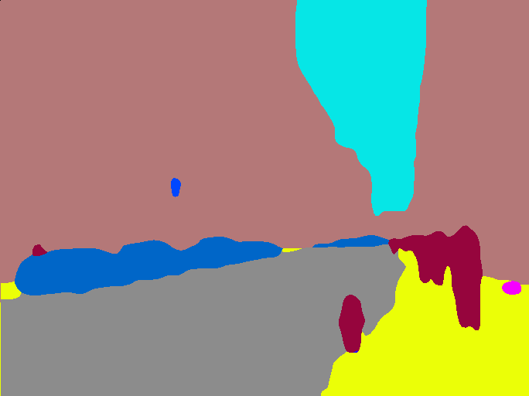


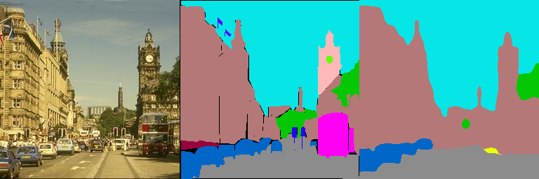
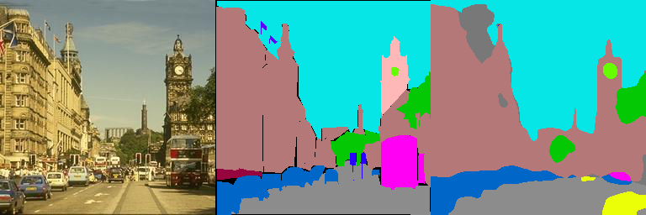
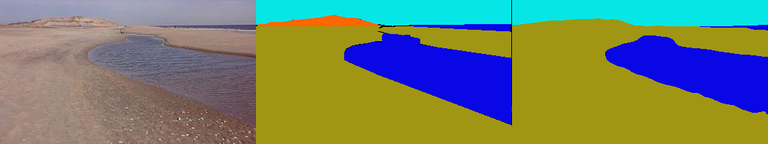
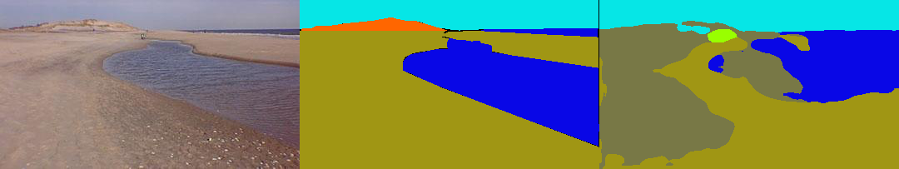
Image Ground Truth DANet PPM-DANet
PPM-DANet can capture more details in the images than DANet (circled in red).
PPM-DANet has worse performance in identifying the big objects and tend to predict more shattered structure (such as the last example). However, as stated before, this can be due to the fact that the PPM-DANet is more complicated in parameters and is harder to train.

